Slide 1
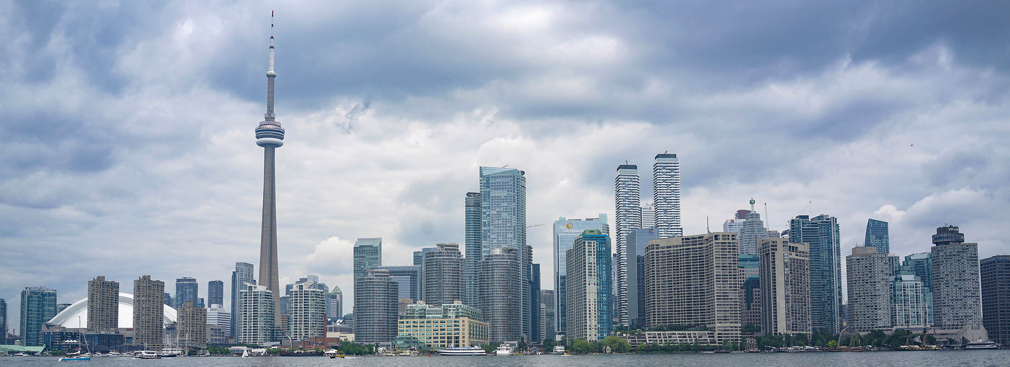
IBM Data Science Professional Certificate
Capstone Project The Battle of the Neighborhoods
Linbo Huang

Slide 2
1.Introduction: Business Problem
In this project we will try to find an optimal location for a restaurant. Specifically, this report will be targeted to stakeholders interested in opening an seafood restaurant in Toronto, ON, Canada.
locations that are not already crowded with much more seafood restaurants.
locations close to rich and safe neighborhood as possible
locations close to areas with more population in the neighborhood
We will use our data science powers to generate a few most promising neighborhoods based on this criteria. Advantages of each area will then be clearly expressed so that best possible final location can be chosen by stakeholders.

Slide 3
2.Data
Based on definition of our problem, factors that will influence our decision are:
number of existing restaurants in the neighborhood (any type of restaurant)
number of existing seafood restaurants in the neighborhood
number of criminal case in the neighborhood.
average income of the neighborhood.
population of the neighborhood.
Following data sources will be needed to extract/generate the required information:
To provide the stakeholders the necessary information we will combine Toronto's newest Census that contains Population, Average income per Neighborhood with Toronot's Neighborhoods shapefile and Foursquare API to collect competitors on the same neighborhoods.Toronto's Census data is publicly available at this website: https://www.toronto.ca/city-government/data-research-maps/open-data/open-data-catalogue/#8c732154-5012-9afe-d0cd-ba3ffc813d5a
Toronto Neighborhoods' shapefile is publicly available at this website: https://www.toronto.ca/city-government/data-research-maps/open-data/open-data-catalogue/#a45bd45a-ede8-730e-1abc-93105b2c439f
Also,we will get the Toronto Crime data from kaggle.com. we can download the data from this website: https://www.kaggle.com/alincijov/toronto-crime-rate-per-neighbourhood

Slide 4
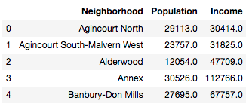
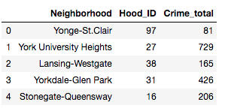
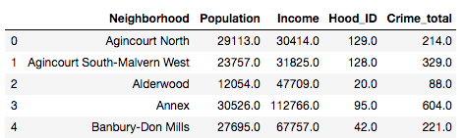
Explore Dataset
140 Neighborhoods
Population, Income
Crime rate
Population, Income, Crime

Slide 5
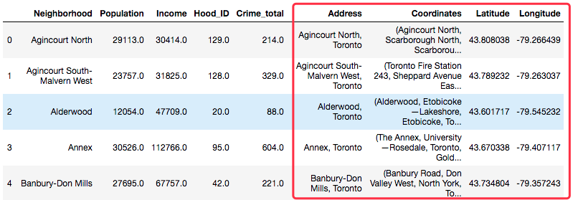
Explore Dataset
140 Neighborhoods
Population, Income, Crime
Get location data
dropna()
Population, Income, Crime, Location[]
110 Neighborhoods

Slide 6
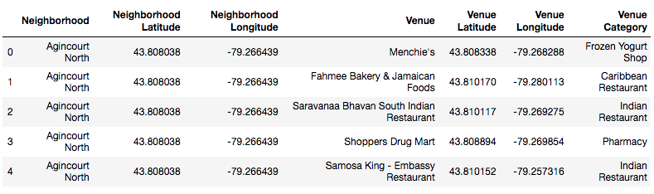
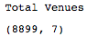
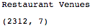
Explore Dataset
Foursquare Venues Data
Restaurant Venues

Slide 7
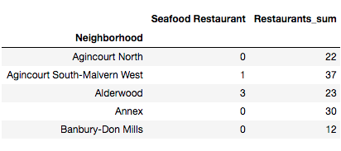
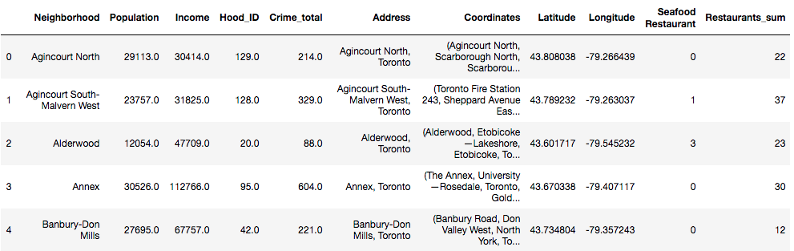
Explore Dataset
Foursquare Venues Data
Population, Income, Crime, Location[]
Population, Income, Crime, Seafood Restaurant, Restaurant, Location[]

Slide 8
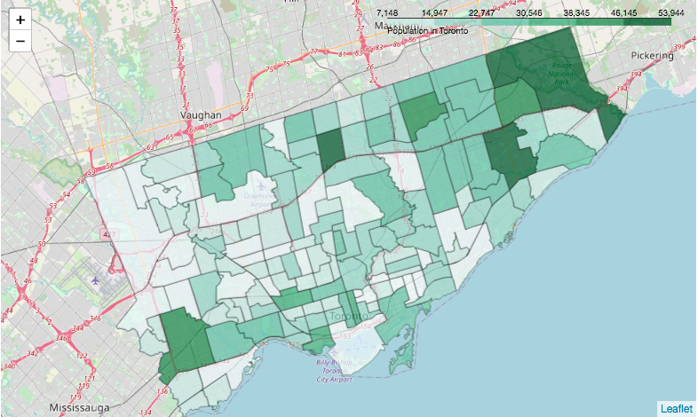
Explore Dataset
Visualize the data
Figure - Population Map in Toronto

Slide 9
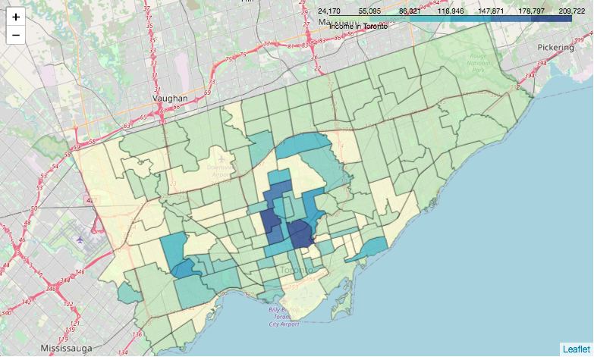
Explore Dataset
Visualize the data
Figure - Income Map in Toronto

Slide 10
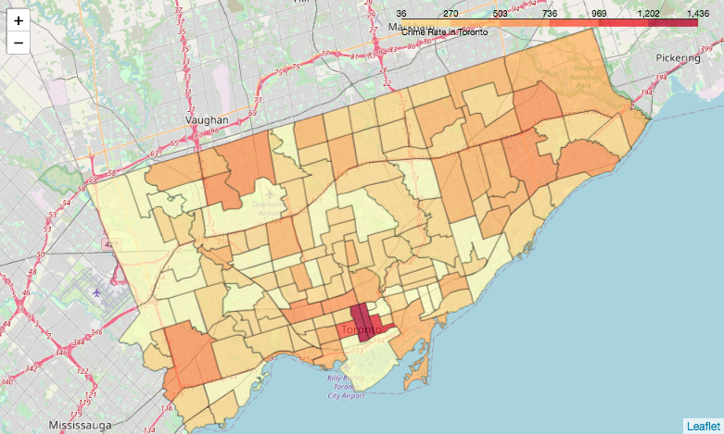
Explore Dataset
Visualize the data
Figure - Crime Map in Toronto

Slide 11
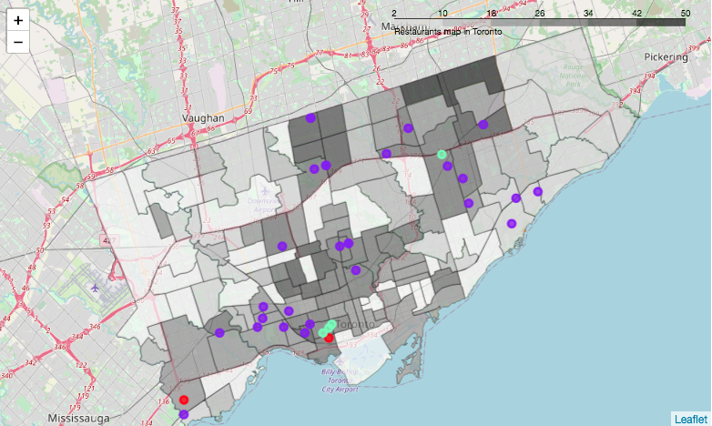
Explore Dataset
Visualize the data
Figure – Restaurants and Seafood Restaurants Map in Toronto

Slide 12
3.Methodology
In this project we will direct our efforts on detecting areas of Toronto that have low restaurant density, particularly those with low number of Seafood restaurants.
In first step we have collected the required data: location and type (category) of every restaurant within 500m from each neighborhood center. We have also identified seafood restaurants (according to Foursquare categorization).
Second step in our analysis will be calculation and exploration of 'restaurant density' across different areas of Toronto - we will use choropleth maps to identify a few promising areas with low number of restaurants in general (and no seafood restaurants in vicinity) .
In third and final step we will use the data to create clusters of locations , and try to find out a cluster that meet some basic requirements established in discussion with stakeholders: we will take into consideration locations with low number of restaurants in the neighborhood, and we want locations without seafood restaurant in radius of 500 meters, we also want locations at lower crime rate and high income neighborhood. We will present map of all such locations but also create clusters (using k-means clustering) of those locations to identify general zones / neighborhoods / addresses which should be a starting point for final 'street level' exploration and search for optimal venue location by stakeholders.

Slide 13
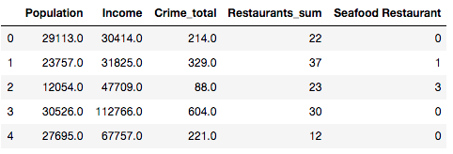
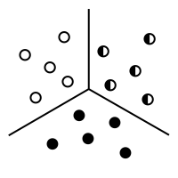
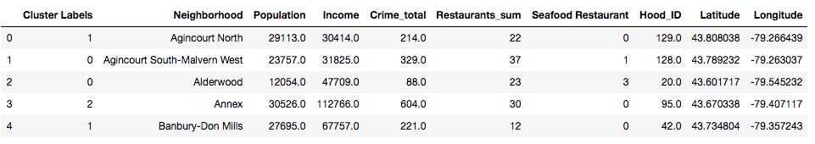
Analysis Data
Population, Income, Crime, Restaurant, Seafood Restaurant,
K-Means Clustering
Cluster Labels, Population, Income, Crime, Restaurant, Seafood Restaurant,

Slide 14
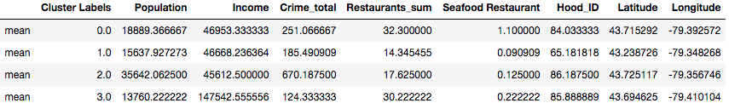
4.Analysis
The clustering results show that the dataset is divided into four categories:
The first group: large population, low income, high crime rate and the largest number of restaurants (including seafood restaurants).
The second group: small population, low income, a moderate crime rate, and the fewest restaurants (including seafood restaurants).
The third group: the largest population, the lowest income, the highest crime rate, and a small number of restaurants (including seafood restaurants).
The fourth group: a small population, the highest income, the lowest crime rate, and a large number of restaurants (including seafood restaurants).

Slide 15
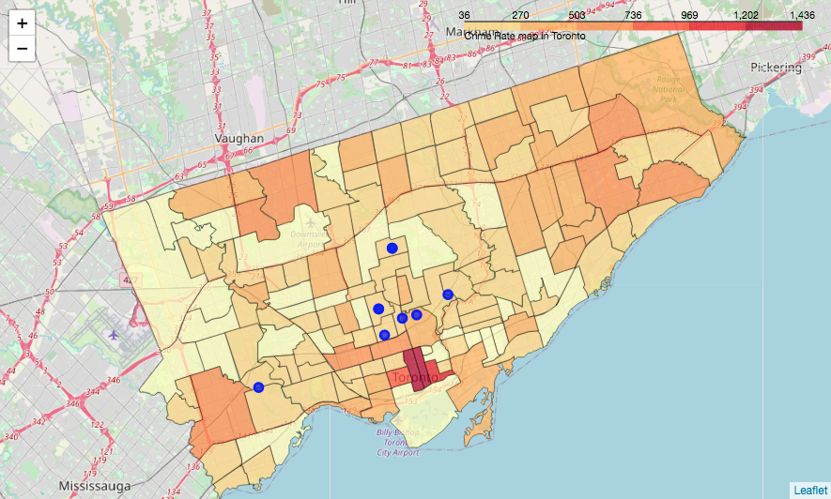
4.Analysis
choose the fourth group which is a group of the highest income and the safest neighborhoods
look at these neighborhood on the different choropleth map
Selected Neighborhoods on the Crime Rate Map

Slide 16
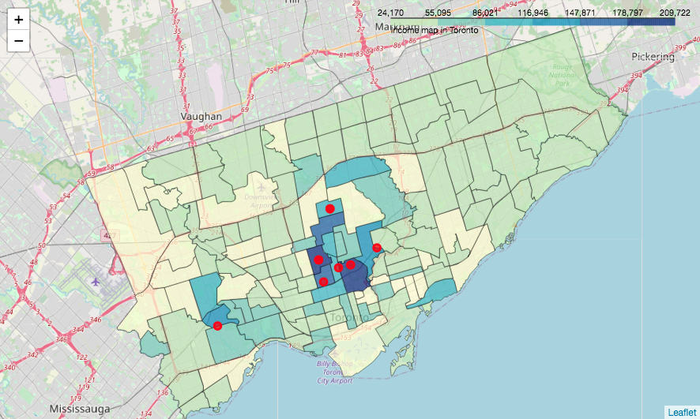
4.Analysis
choose the fourth group which is a group of the highest income and the safest neighborhoods
look at these neighborhood on the different choropleth map
(2) Selected Neighborhoods on the Income Map

Slide 17
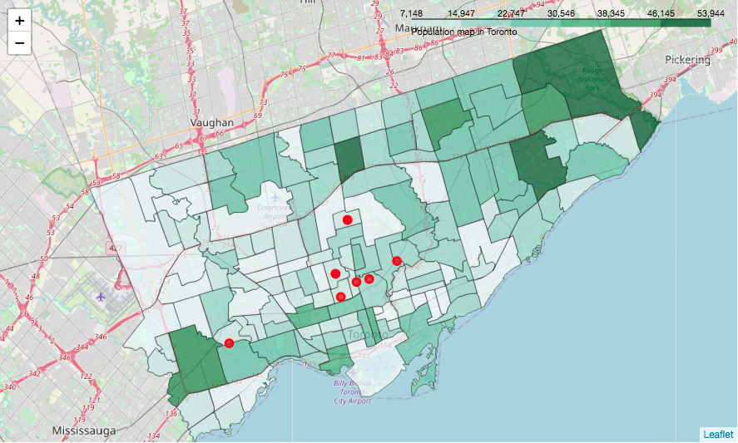
4.Analysis
choose the fourth group which is a group of the highest income and the safest neighborhoods
look at these neighborhood on the different choropleth map
(3) Selected Neighborhoods on the Population Map

Slide 18
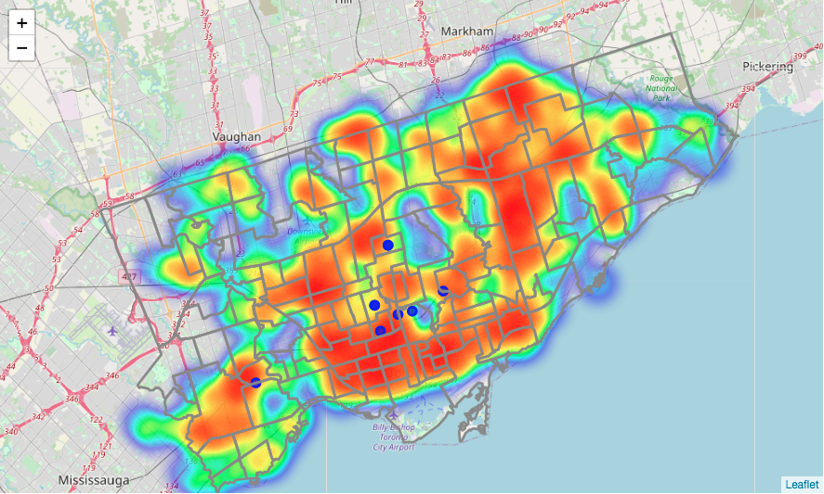
4.Analysis
choose the fourth group which is a group of the highest income and the safest neighborhoods
look at these neighborhood on the different choropleth map
(4) Selected Neighborhoods on the Restaurants Map (By Heatmap)

Slide 19
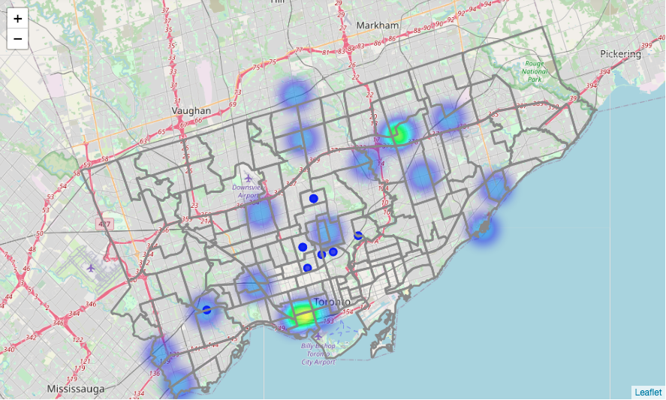
4.Analysis
choose the fourth group which is a group of the highest income and the safest neighborhoods
look at these neighborhood on the different choropleth map
(5) Selected Neighborhoods on the Sedfood Restaurants Map (By Heatmap

Slide 20
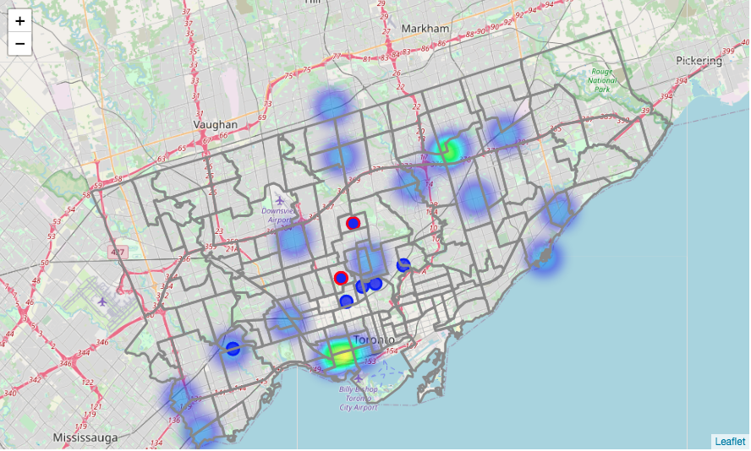
5.Results
According to several choropleth maps, we will eventually choose a location in Lawrence Park South or Forest Hill to open a seafood restaurant. There are currently no seafood restaurant in these two neighborhoods, also there are just relatively few restaurants and low crime rate, higher income residents and a moderate population.
Lawrence Park South
Forest Hill

Slide 21
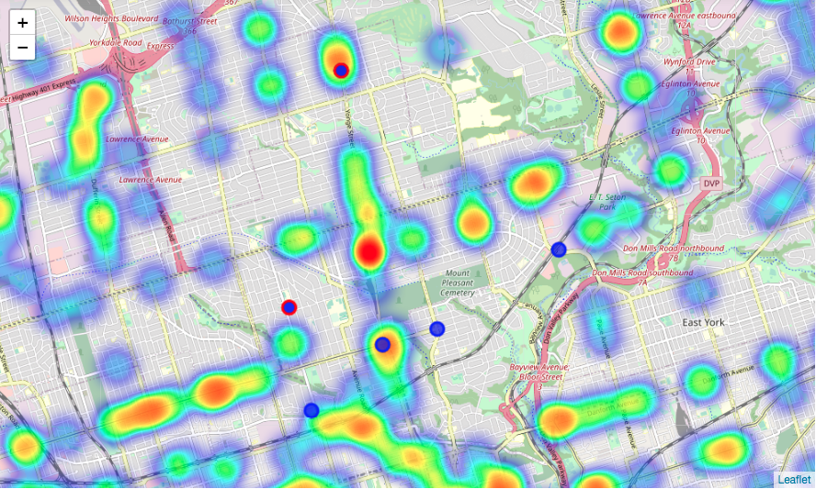
6.Conclusion
Final decision on optimal restaurant location will be made by stakeholders based on specific characteristics of neighborhoods and locations in every recommended zone, taking into consideration additional factors like attractiveness of each location (proximity to park or water), levels of noise / proximity to major roads, real estate availability, prices, social and economic dynamics of every neighborhood etc.

